Slide 1

Internet and Web Basics
Certificate presentation
Name: Muhammed Razal
Group: 4220Z

Slide 2
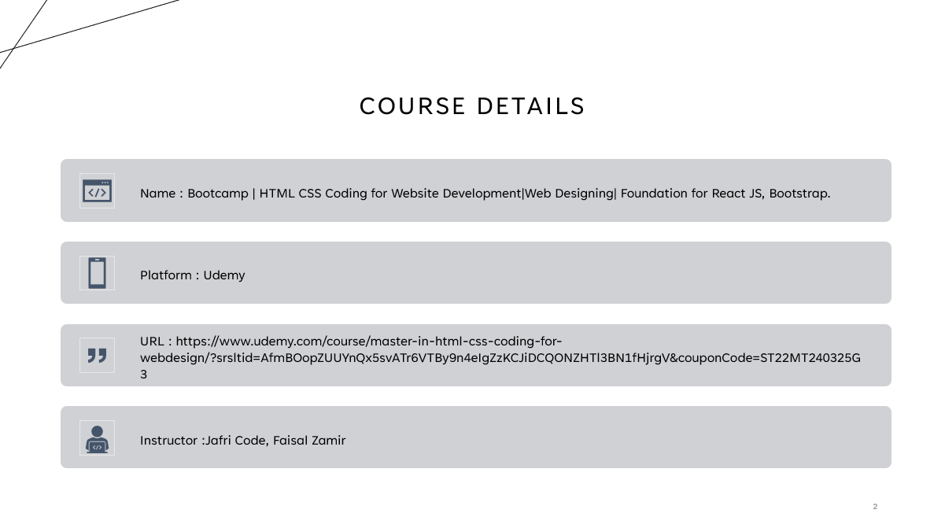
Course Details
Name : Bootcamp | HTML CSS Coding for Website Development|Web Designing| Foundation for React JS, Bootstrap.
Platform : Udemy
URL : https://www.udemy.com/course/master-in-html-css-coding-for-webdesign/?srsltid=AfmBOopZUUYnQx5svATr6VTBy9n4eIgZzKCJiDCQONZHTl3BN1fHjrgV&couponCode=ST22MT240325G3
Instructor :Jafri Code, Faisal Zamir

Slide 3
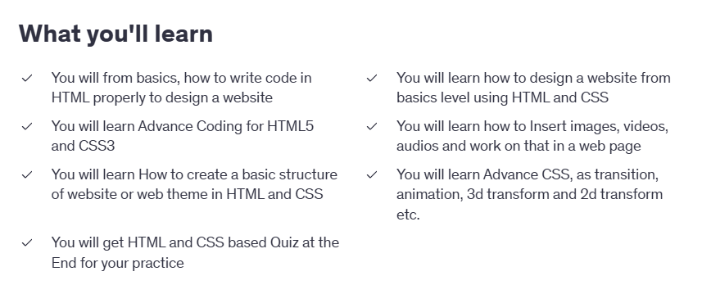
Course Details

Slide 4
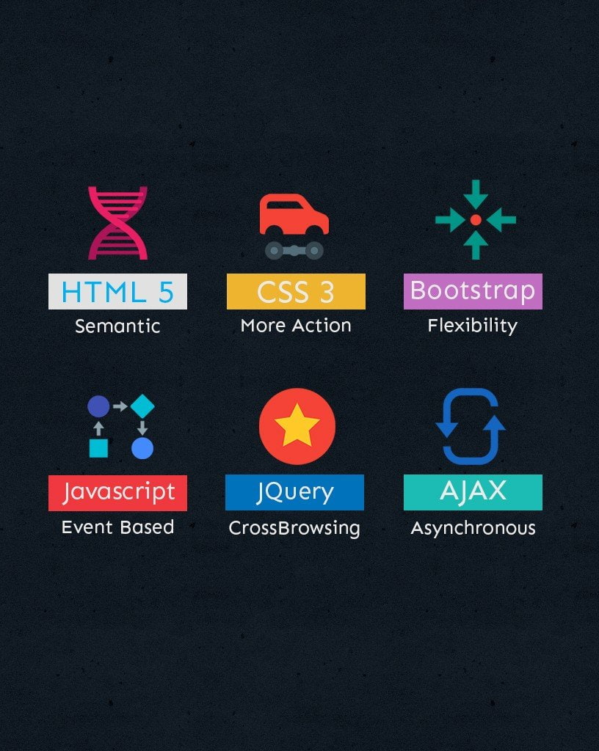
Course Details
This course contains All Video lectures and Study materials related to HTML and CSS. These are two technologies that are necessary to learn if you want to become a Web Designer.
To your knowledge, there are two things in website creation, one is the frontend, and the other is the backend. You can cover Frontend section of website creation using HTML and CSS or with other skills (optional).
So, in this course, the main purpose is To Provide Full Practical Coding in HTML and CSS as well as theoretical knowledge too.

Slide 5
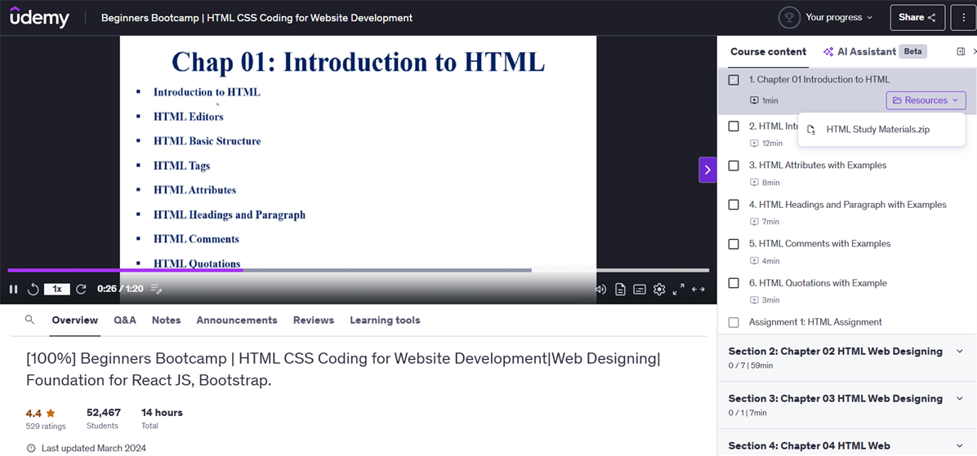
Landing page

Slide 6
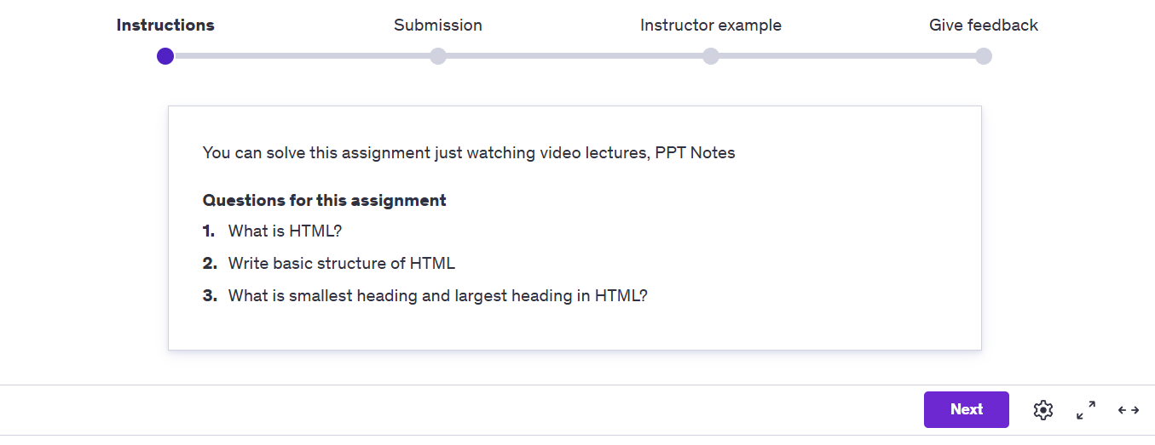
Assignments
After every lesson is completed, you get an assignment. This can be questions to elaborate or multiple choices.

Slide 7
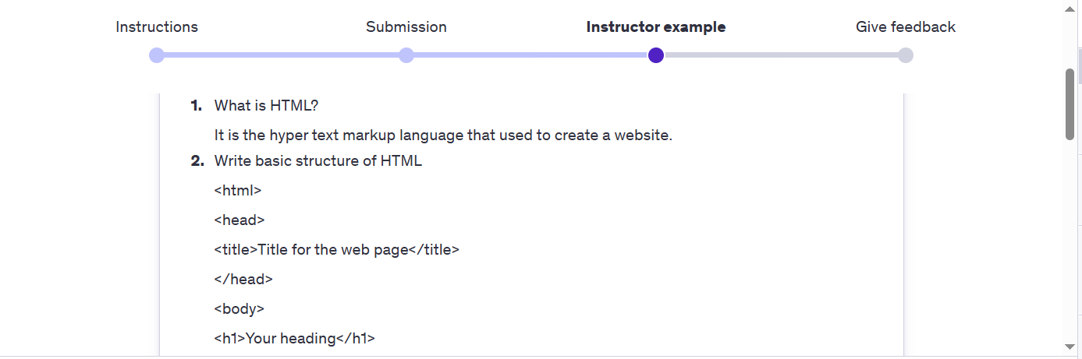
Assignment 1
For example, this is the assignment for the first section where I had to answer 3 descriptive questions. And after the assignment you receive the answer given by the instructor and a feedback too.

Slide 8
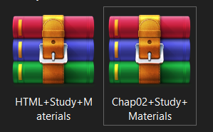
Resources
Also in every section, you receive resourcecs to use refer and learn in .rar format which can later be extracted and used.

Slide 9
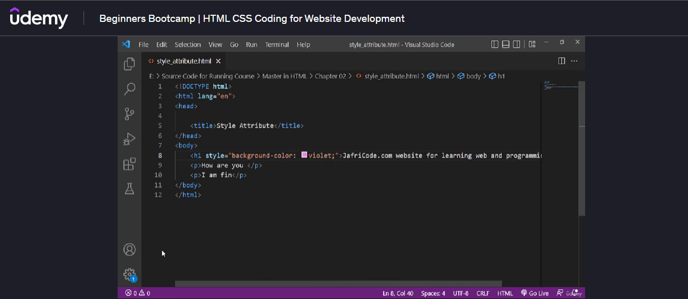
Getting started with CSS in Section 2

Slide 10
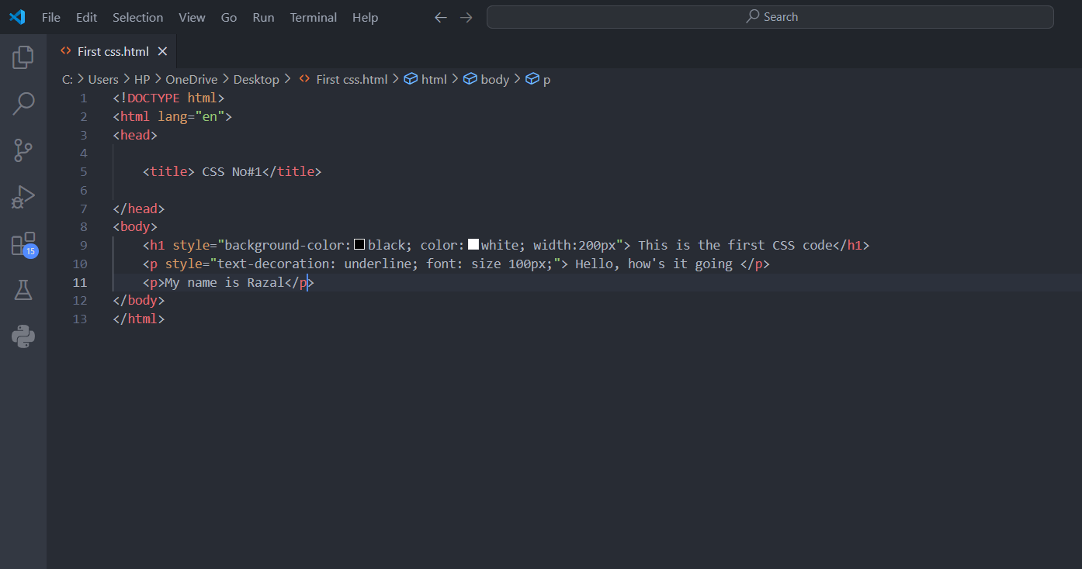
This is the first code from the course where CSS was used and was made is VS code where all the coding will be done

Slide 11
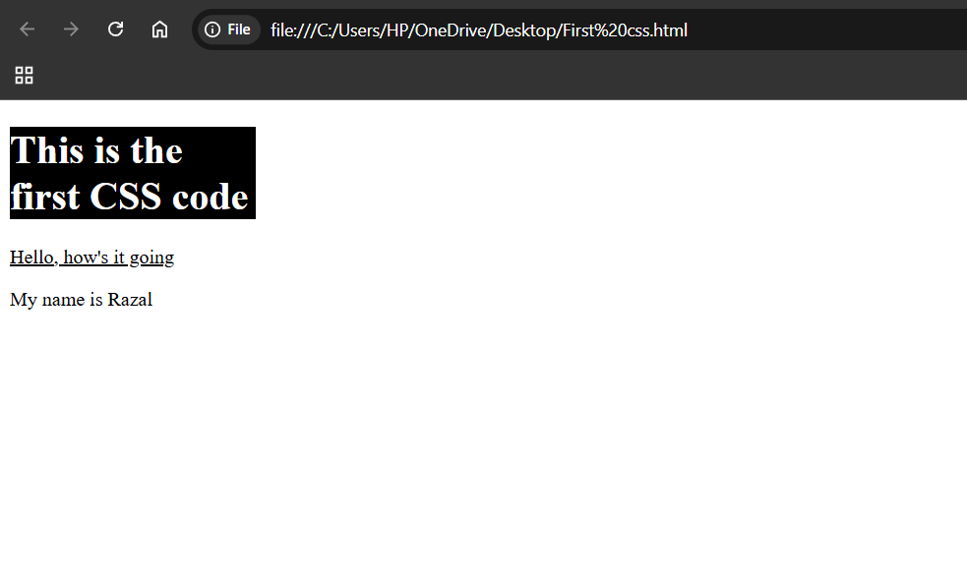
Output

Slide 12
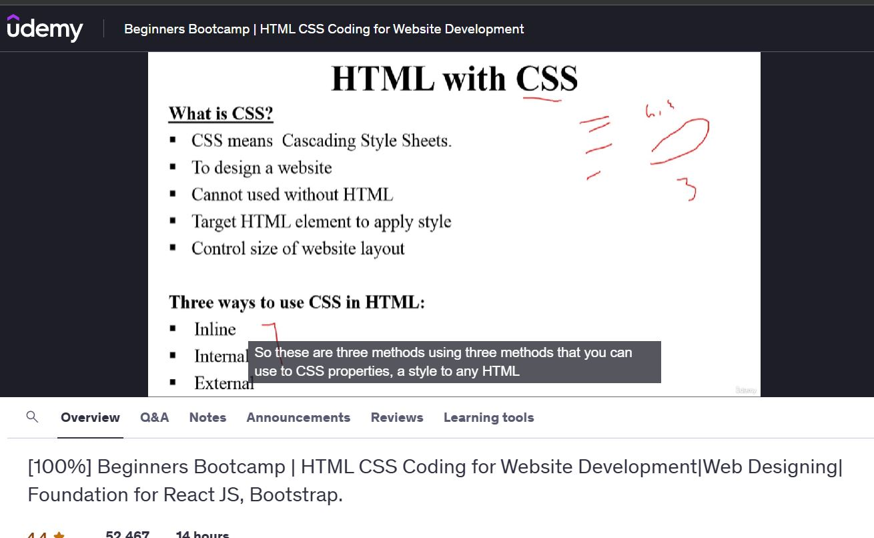
Getting deep into CSS and different ways to use CSS

Slide 13
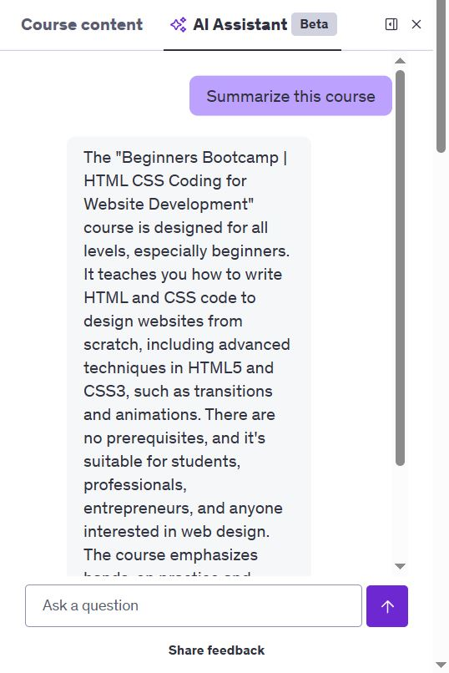
AI feature inside the course to help with lessons
The AI assistant in Udemy summarizes course content, allowing quick reviews of key concepts.
It provides concise explanations and highlights important topics for efficient learning.
It answers questions and offers personalized insights to enhance understanding throughout the course.

Slide 14
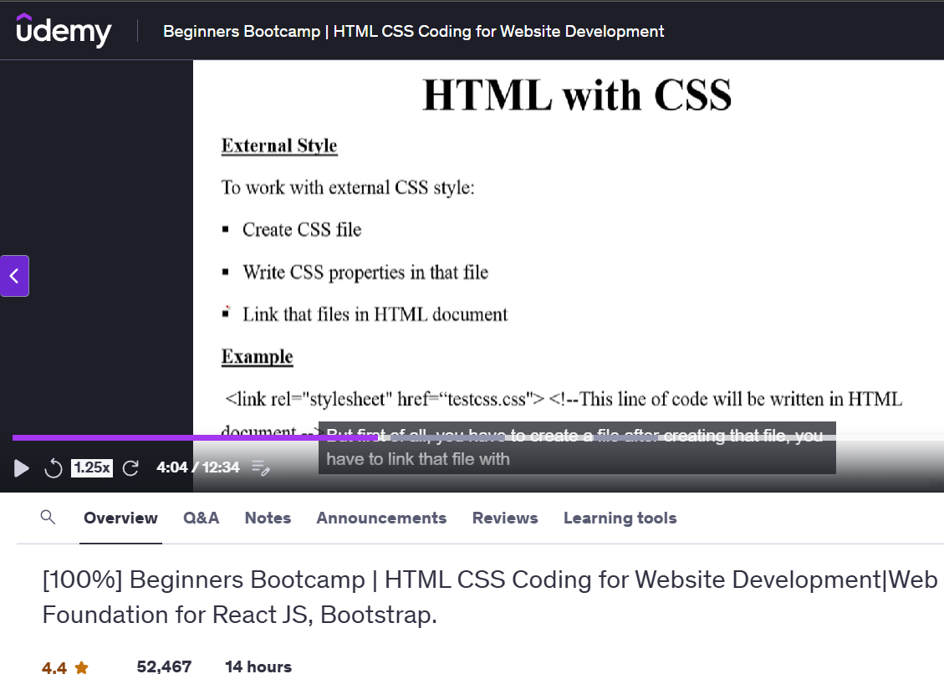
New concept of external CSS Style

Slide 15
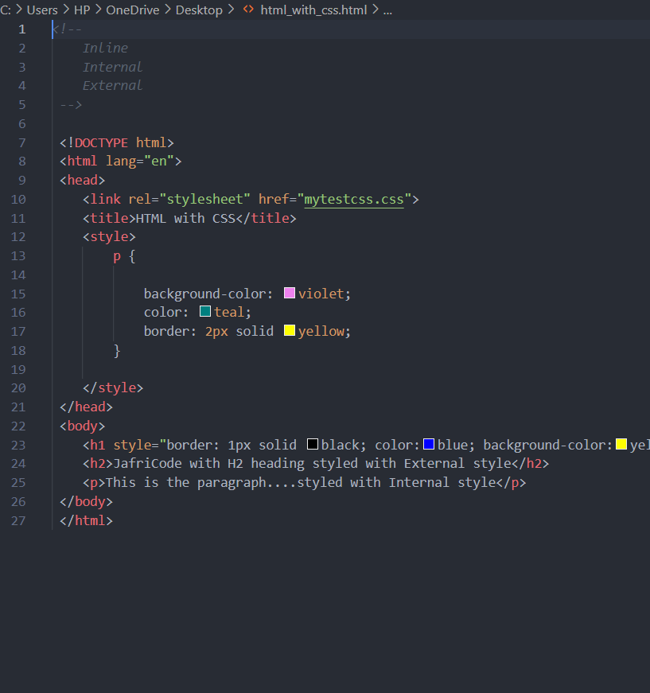
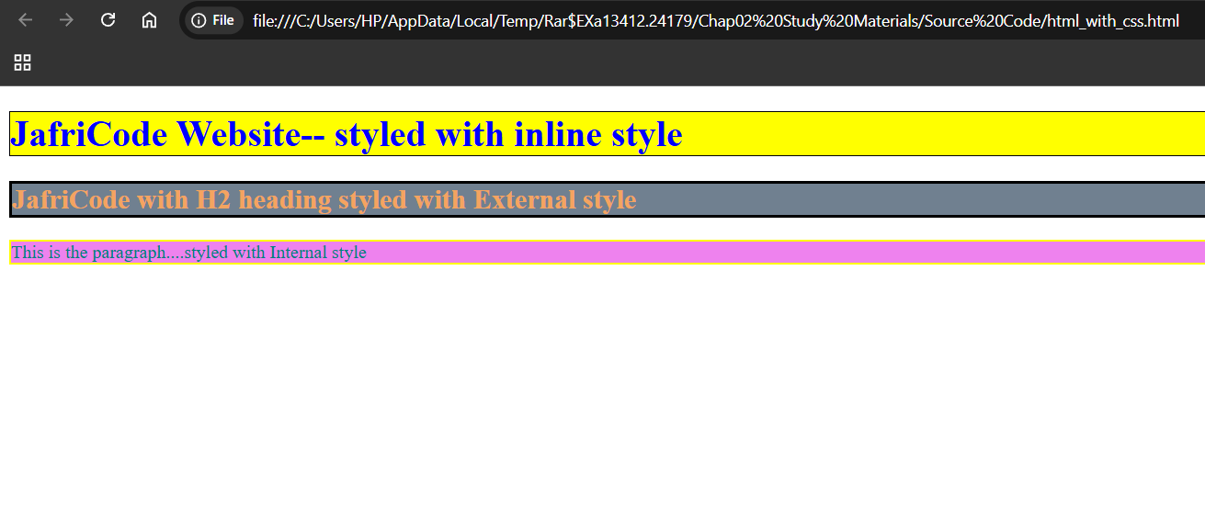
Code Example
Code
Output

Slide 16
Thank you
Completed 35%
The course and presentation will be continued…………..

